Slide 1
Floating point textures
Advanced Graphics Programming

Slide 2
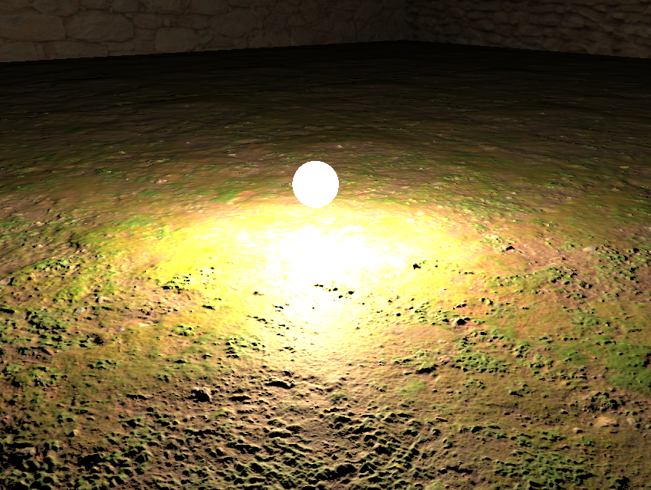
8-bit color textures
Typically we use:
GL_RGBA / GL_UNSIGNED_BYTE
1 byte per color component
256 values
In GLSL values from 0 to 1
What happens if a fragment is illuminated very intensely?
Loss of information
Could be useful for post-processing
Fragments stored into a color texture...

Slide 3


8-bit color textures
Typically we use:
GL_RGBA / GL_UNSIGNED_BYTE
1 byte per color component
256 values
In GLSL values from 0 to 1
What happens if normal vectors don’t have enough precision? Look at the surface of the reflective sphere
Loss of information
Normals read from a color texture...

Slide 4
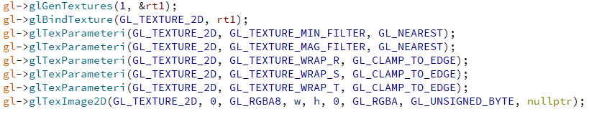
8-bit color textures
These are the typical calls to create a color texture...

Slide 5
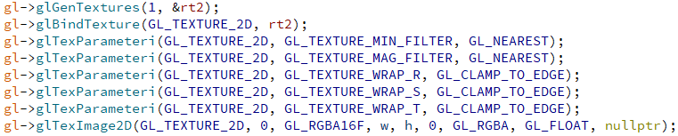
Floating-point textures
Just change these flags when allocating the texture on the GPU

Slide 6
8-bit color textures
Now we use:
GL_RGBA16F / GL_FLOAT
2 bytes per color component
Very high precision!
In GLSL, not restricted to range 0 to 1
Ok the pixels still look too bright...
But the information is there
Values over 1 are effectively stored in the texture for further processing...
Fragments stored into a color texture...

Slide 7

8-bit color textures
Now we use:
GL_RGBA16F / GL_FLOAT
2 bytes per color component
Very high precision!
In GLSL, not restricted to range 0 to 1
Look now at the reflective sphere, with normals encoded with enough precision, the results are nice.
No visible loss of information
Normals read from a float texture...

Slide 8

Questions?

